Slide 1
Password Based
Circuit Breaker
By
Vaibhav Mojidra

Slide 2
SUMMARY
Password Based Circuit Breaker is a simple project that helps in controlling the electrical lines with the help of a password.
Nowadays, electrical accidents to the line man are increasing, while repairing the electrical lines due to the lack of communication between the electrical substation and maintenance staff. This project gives a solution to this problem to ensure line man safety. In this proposed system, the control (ON/OFF) of the electrical lines lies with line man. This project is arranged in such a way that maintenance staff or line man has to enter the password to ON/OFF the electrical line.
Now, if there is any fault in electrical line, then the line man will switch off the power supply to the line by entering password and comfortably repair the electrical line, and after coming to the substation line man switch on the supply to the particular line by entering the password. Separate passwords are assigned for each electrical lines.

Slide 3
INTRODUCTION
The electric line man safety system is designed to control a circuit breaker by using a password for the safety of electric man. This proposed system provides a solution that ensures safety of maintenance staff, i.e., line man. Now, if there is any fault in electrical line, then the line man will switch off the power supply to the line by entering password and comfortably repair the electrical line, and after coming to the substation line man switch on the supply to the particular line by entering the password. Separate passwords are assigned for each electrical lines. The control to turn on or off the line will be maintained by the line man only because this system has an arrangement such that a password is Arduino required to operate the circuit breaker (on/off). A matrix keypad is interfaced to the microcontroller to enter the password. The entered password is compared with the password generated. If the password entered is correct, only then the line can be turned ON/OFF.

Slide 4
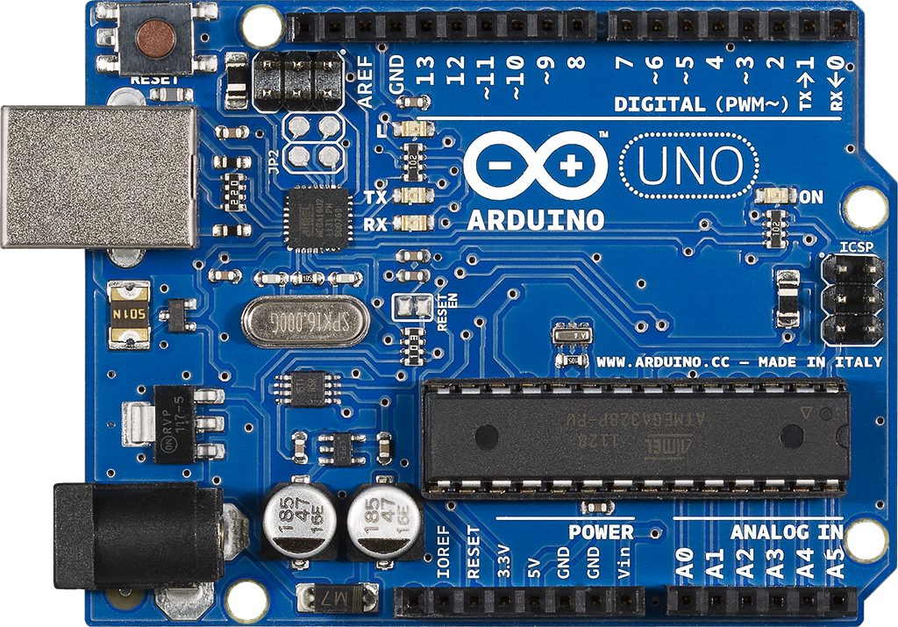
MAIN BUILDING BLOCK
Arduino UNO

Slide 5
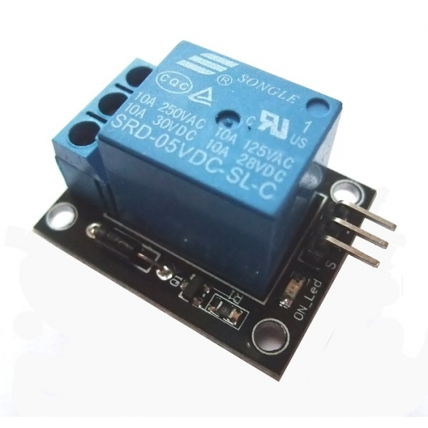
5V Relay

Slide 6
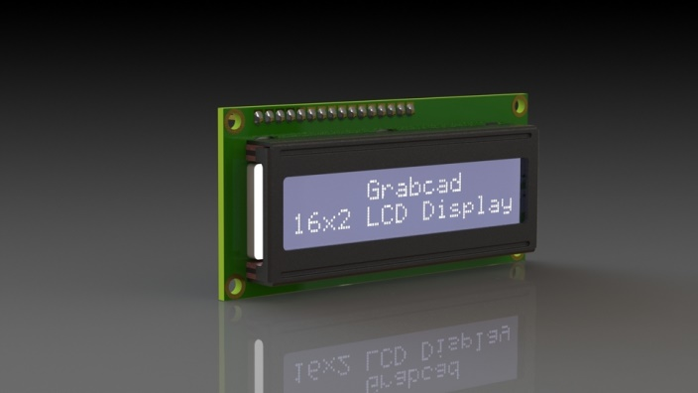
16 x 2 LCD Display

Slide 7
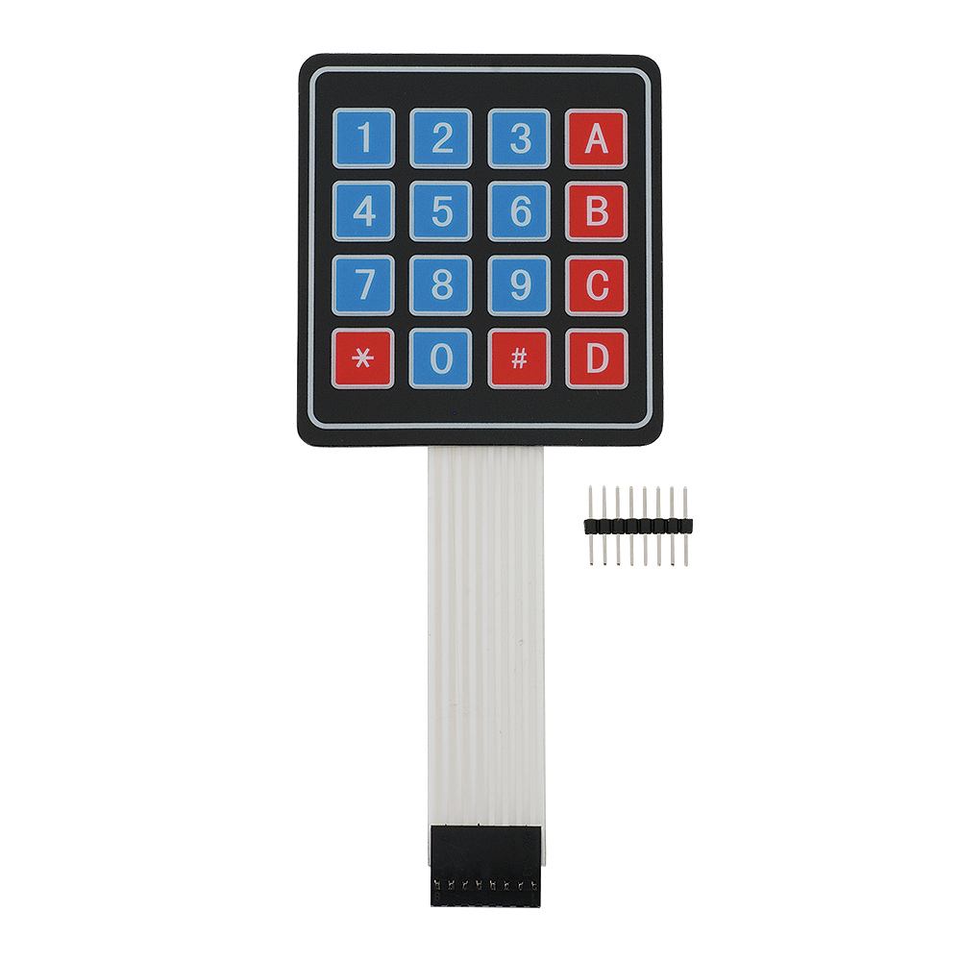
4 x 4 Matrix Keypad

Slide 8
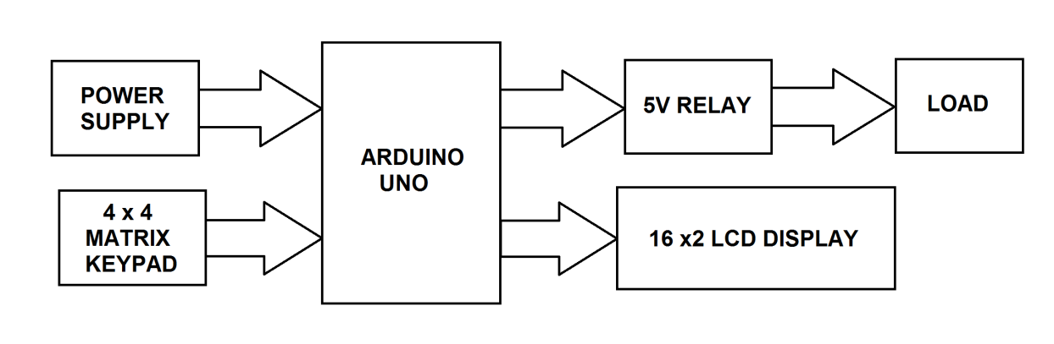
BLOCK DIAGRAM

Slide 9
PIN
DIAGRAM
OF
THE
MODULE

Slide 10
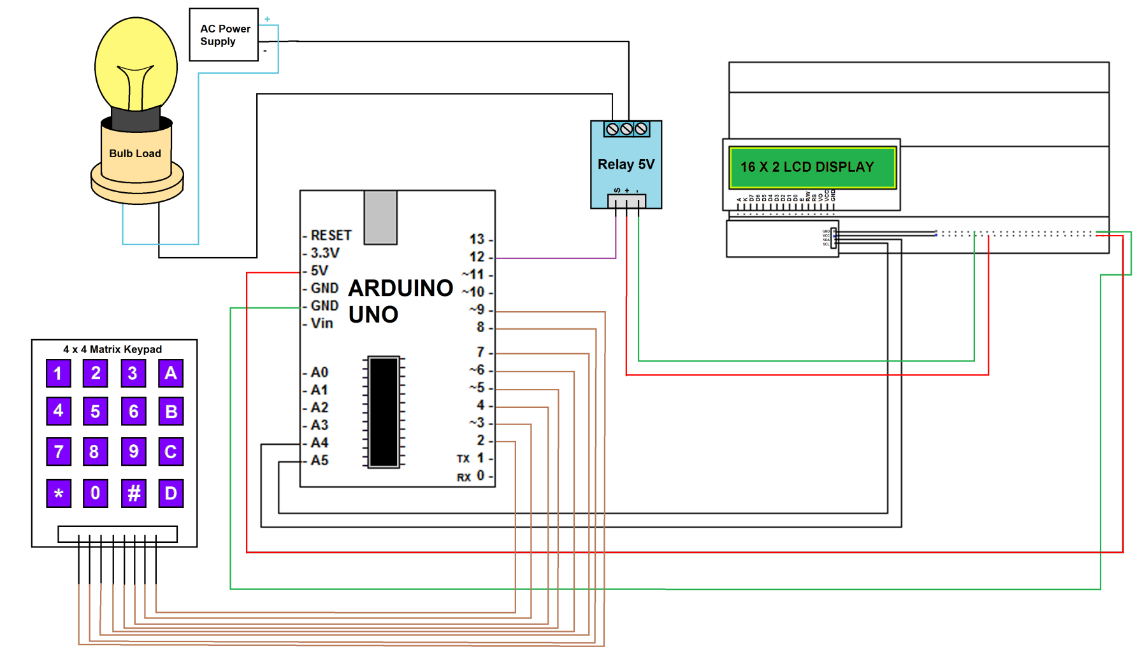
PIN DIAGRAM

Slide 11
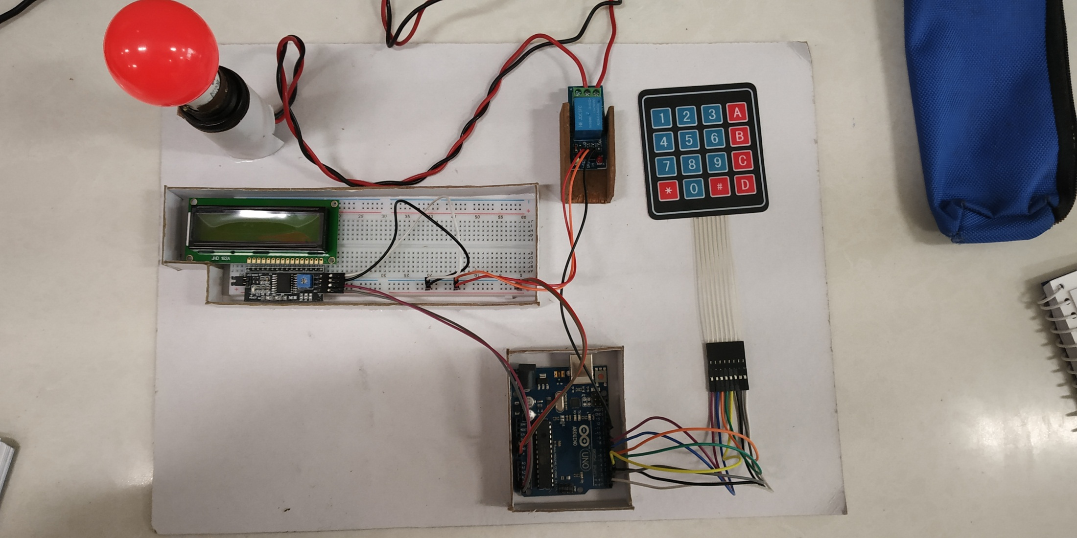
HARDWARE SETUP

Slide 12
APPLICATIONS
It is used in electrical substations to ensure line man safety.
Password based circuit breaker is used in buildings and houses.
Used for saving power in hotels and shopping malls.
It can also be used as Password based Load Control system or Password Based electrical appliance control.
It is used in well-known companies where security is prime concern.

Slide 13
LIMITATIONS
After the installation the maintenance cost increases.
The programming of this system is too large and complicated.
By forgetting the password it becomes difficult to operate the system.
The password cannot be enclosed by anyone other than who knows the password and this can cause problem when that person is not there and there may be emergency.
Harder and more costly to obtain high short circuit interrupting capacities.

Slide 14
FUTURE AND SCOPE
Development in Electrical power transmission system requires the use of circuit breakers with increasing breaking capacity.
It can also be interfaced with a GSM modem for remotely controlling the electronic circuit breaker via SMS

Slide 15
THANK YOU

